Slide 1
Precis Writing for CSS
JINSAR ALEE BHATTI (47 CTP)

Slide 2
Purpose of Precis Writing
Precis writing tests comprehension, analysis, and expression.
It is a summary written in concise form.
PURPOSE
To express the core idea briefly, clearly, and accurately.
Reflects candidate’s clarity, discipline, and command of English

Slide 3
Rules of Precis Writing
RULES
Written in Indirect Speech
Third Person narration
Past Tense
Passive Voice preferred
Avoid examples and details
Concise, clear, and faithful to the text
No personal opinions or additions

Slide 4
Steps to Understand the Passage
Third Reading (if needed): Ensure complete understanding
First Reading: Skim quickly for overall meaning
Second Reading: Careful and thorough

Slide 5
Rough Draft 1: Points only
M
A
K
I
N
G
D
R
A
F
T
Rough Draft 2: Convert points into passage
Final Draft:
Title
Grammatically Correct Passage

Slide 6
SAMPLE PASSAGE
The terrorist attacks of September 11, 2001, marked one of the darkest days in modern history. On that morning, hijackers seized four commercial airplanes, crashing two of them into the Twin Towers of the World Trade Center in New York City and another into the Pentagon near Washington, D.C. The fourth plane, believed to be targeting another high-profile site, crashed in Pennsylvania after passengers resisted the hijackers. Nearly 3,000 innocent people lost their lives, and the incident shook the entire world. The attacks not only exposed global vulnerability to terrorism but also transformed international politics, security measures, and foreign policies. The United States launched a “War on Terror,” leading to military interventions in Afghanistan and Iraq, while stricter security regulations became the norm worldwide. The events of 9/11 left a profound psychological, political, and cultural impact, reminding nations of the need for vigilance, unity, and global cooperation against terrorism.

Slide 7
ROUGH
DRAFT
01
The attacks of September 11, 2001, had been regarded as one of the darkest days of modern history.
Hijackers had seized four planes, two of which had struck the Twin Towers, one had hit the Pentagon, and another had crashed in Pennsylvania after passengers resisted.
Nearly 3,000 innocent lives had been lost, and the entire world had been shaken.
The attacks had exposed global vulnerability to terrorism.
They had transformed international politics, security measures, and foreign policies.
The United States had launched a “War on Terror,” which had resulted in interventions in Afghanistan and Iraq.
Stricter global security regulations had become the norm.
The incident had left psychological, political, and cultural impacts, reminding nations of vigilance, unity, and cooperation against terrorism.

Slide 8
TURNING POINTS INTO A PASSAGE
ROUGH
DRAFT II
The attacks of September 11, 2001, had been considered one of the darkest days in history. Four planes had been hijacked, two of which had struck the Twin Towers, one had hit the Pentagon, while the fourth had crashed in Pennsylvania after passengers resisted. Nearly 3,000 innocent people had lost their lives, and the world had been shaken. The tragedy had revealed global vulnerability to terrorism and had altered international politics, foreign policies, and security measures. The United States had initiated a “War on Terror,” resulting in military interventions in Afghanistan and Iraq, while stricter global security measures had been enforced. The incident had left lasting psychological, political, and cultural impacts, reminding nations of vigilance and unity against terrorism.

Slide 9
FINAL DRAFT PRE-REQUISITES
One Title on the top of final passage.
Ensure the last passage is grammatically correct.
ii. Ensure no original text is in the final passage.

Slide 10
Title: Terrorism and the Reshaping of Global Security
ROUGH
DRAFT II
The 9/11 attacks, among history’s darkest events, had shaken the world as hijacked planes destroyed the Twin Towers, struck the Pentagon, and crashed in Pennsylvania. Nearly 3,000 lives had been lost, exposing global vulnerability to terrorism. The tragedy had reshaped world politics, security, and foreign policies, leading the United States to launch the “War on Terror” and enforce stricter global security. Its lasting impact had reminded nations of vigilance, unity, and cooperation against terrorism.

Slide 11
Key Takeaways
Length: 1/3 of original passage
Nothing of your own
Three drafts
One short, suitable title
Style: Past tense, Indirect speech, Passive voice, Third person

Slide 12
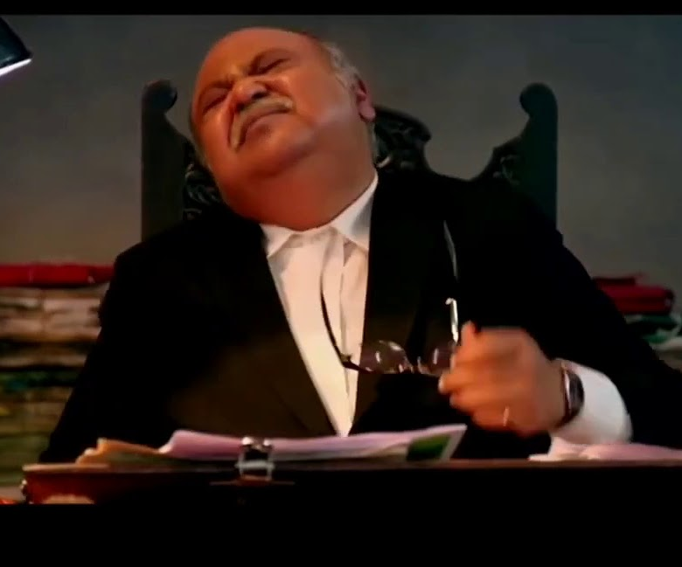
ANY QUESTIONS?

